Slide 1
Go with the Flow for Your Custom Global Navigation
Speaker: Derek Cash-Peterson

Slide 2






Derek Cash-Peterson Principal Architect Professional developer since 1999 Working with SharePoint since 2006 Specialize in branding/UX development https://spdcp.com linkedin.com/in/derek-cash-peterson-6320752 @spdcp https://github.com/dcashpeterson

Slide 3

Scenario
A large multi-national insurance company was moving their intranet from a legacy system to SharePoint Online. They required a custom layout for their navigation. They required three levels of navigation and needed everything to be editable by non-technical users.

Slide 4
Solution
Leverage the PnP Dev Extensions to create a custom header/footer control using a JSON file for data. Use SharePoint lists to permission access and allow non-technical users to edit link data. Used Power Automate to create the JSON data needed to drive the navigation and save it in a SharePoint library.

Slide 5
Standard Navigation Update Process
Need Change to Navigation
Call Developer or Open Support Ticket
Wait for developer to have time
Developer makes change
Review Change
Iterate on change
Approve Change
Wait for Change Window
Launch Change

Slide 6
Agenda
Current Options for Navigation
Anatomy of the Solution
Solution Architecture
Q&A

Slide 7
Agenda
Current Options for Navigation
Anatomy of the Solution
Solution Architecture
Q&A

Slide 8

Current Options for Navigation
Hub Site Header
Site Navigation
Site Footer
Quick Launch

Slide 9
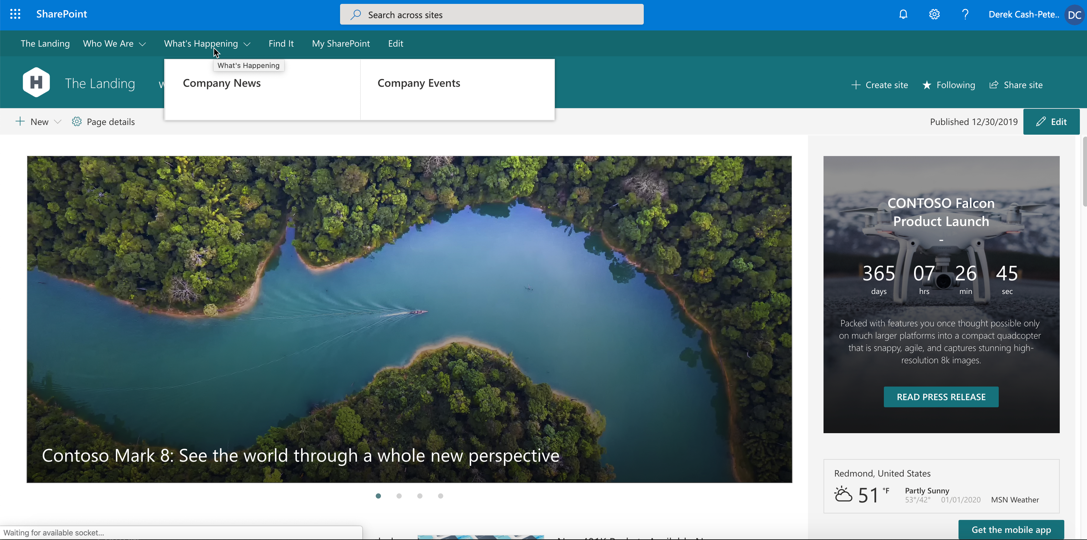
Hub Site Header

Slide 10
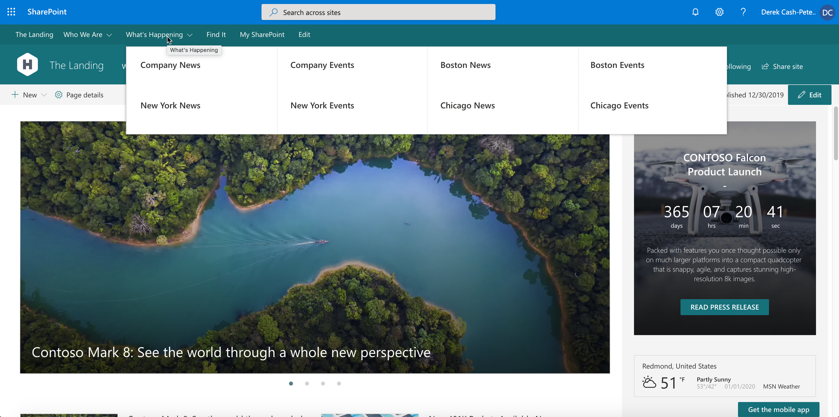
Hub Site Header

Slide 11
Hub Site Header
Pros

Slide 12
Hub Site Header
Pros
Easy to use

Slide 13
Hub Site Header
Pros
Easy to use
Multi-level

Slide 14
Hub Site Header
Pros
Easy to use
Multi-level
Allows for manual edits

Slide 15
Hub Site Header
Pros
Easy to use
Multi-level
Allows for manual edits
Mega-menu capabilities

Slide 16
Hub Site Header
Pros
Easy to use
Multi-level
Allows for manual edits
Mega-menu capabilities
Responsive

Slide 17
Hub Site Header
Pros
Easy to use
Multi-level
Allows for manual edits
Mega-menu capabilities
Responsive
Excellent for a single hub experience

Slide 18
Hub Site Header
Cons

Slide 19
Hub Site Header
Cons
Takes up a lot of real-estate

Slide 20
Hub Site Header
Cons
Takes up a lot of real-estate
Limited to 3 levels

Slide 21
Hub Site Header
Cons
Takes up a lot of real-estate
Limited to 3 levels
Quickly gets overloaded

Slide 22
Hub Site Header
Cons
Takes up a lot of real-estate
Limited to 3 levels
Quickly gets overloaded
Limited to single hub

Slide 23
Hub Site Header
Cons
Takes up a lot of real-estate
Limited to 3 levels
Quickly gets overloaded
Limited to single hub
Not global

Slide 24
Hub Site Header
Cons
Takes up a lot of real-estate
Limited to 3 levels
Quickly gets overloaded
Limited to single hub
Not global
No control over fonts and colors

Slide 25
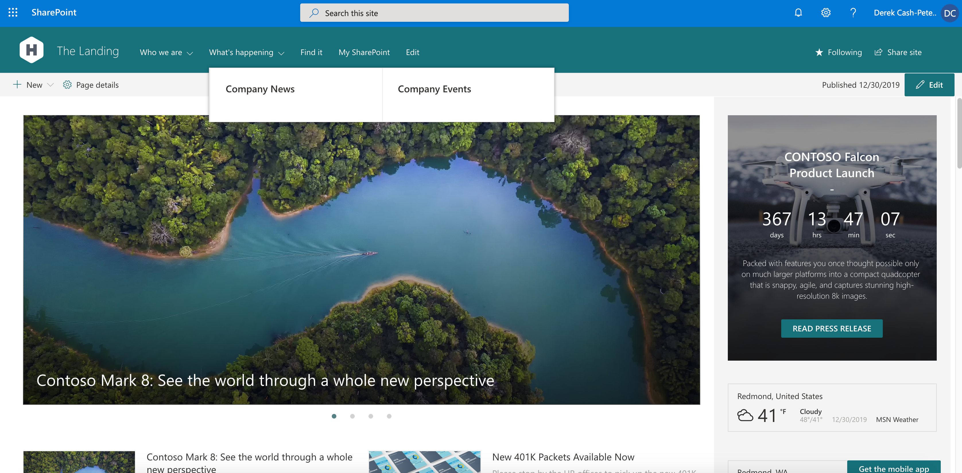
Site Navigation

Slide 26
Site Navigation
Pros

Slide 27
Site Navigation
Pros
Easy to use
Multi-level
Allows for manual edits
Mega-menu capabilities
Responsive

Slide 28
Site Navigation
Pros
Easy to use
Multi-level
Allows for manual edits
Mega-menu capabilities
Responsive
Perfect for in-site navigation

Slide 29
Site Navigation
Cons

Slide 30
Site Navigation
Cons
Takes up a lot of real-estate
Limited to 3 levels
Quickly gets overloaded
Not global
No control over fonts and colors

Slide 31
Site Navigation
Cons
Takes up a lot of real-estate
Limited to 3 levels
Quickly gets overloaded
Not global
No control over fonts and colors
Limited to the current site

Slide 32
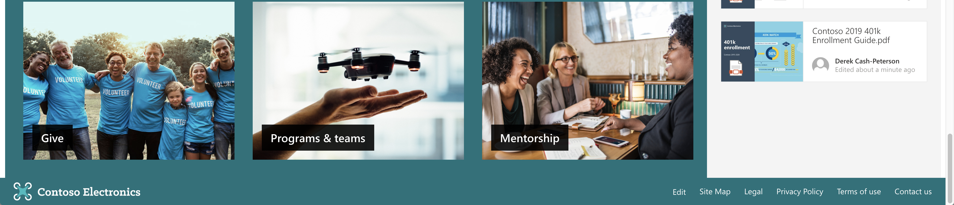
Site Footer

Slide 33
Site Footer
Pros

Slide 34
Site Footer
Pros
Easy to use
Allows for manual edits
Responsive

Slide 35
Site Footer
Pros
Easy to use
Allows for manual edits
Responsive
Easy way to show links in a complex site
Anchored to bottom of page

Slide 36
Site Footer
Cons

Slide 37
Site Footer
Cons
Single Level

Slide 38
Site Footer
Cons
Single Level
No Headers

Slide 39
Site Footer
Cons
Single Level
No Headers
Limited to a single site

Slide 40
Site Footer
Cons
Single Level
No Headers
Limited to a single site
Not global

Slide 41
Site Footer
Cons
Single Level
No Headers
Limited to a single site
Not global
Needs to be recreated to be consistent

Slide 42
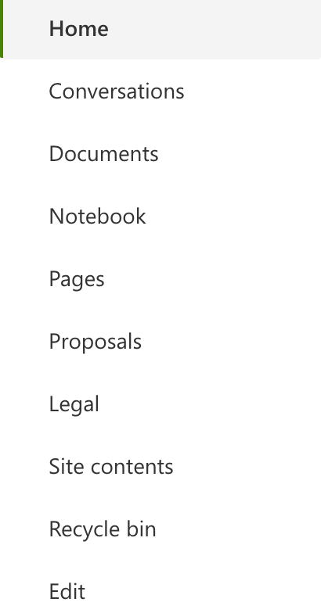
Quick Launch

Slide 43
Quick Launch
Pros

Slide 44
Quick Launch
Pros
Easy to use
Multi-level
Allows for manual edits

Slide 45
Quick Launch
Pros
Easy to use
Multi-level
Allows for manual edits
Perfect for team or collaboration sites

Slide 46
Quick Launch
Cons

Slide 47
Quick Launch
Cons
Limited to 3 levels
Not global
No control over fonts and colors

Slide 48
Quick Launch
Cons
Limited to 3 levels
Not global
No control over fonts and colors
Only available on Team Sites

Slide 49
Agenda
Current Options for Navigation
Anatomy of the Solution
Solution Architecture
Q&A

Slide 50

Anatomy of the Solution
Admin Site with Link Lists
Custom Navigation Component
Power Automate

Slide 51

Administration Site
Modern Team Site
Two Links Lists (Level 1 and Level 2)
Permission locked down to only the admin team

Slide 52
Demo

Slide 53

Custom Navigation Component
Used PnP Dev Extensions
Updated the User Interface
Deployed Component across the tenant

Slide 54
What is PnP?

Slide 55
What is PnP?
Patterns & Practices

Slide 56
What is PnP?
Patterns & Practices
Community Driven

Slide 57
What is PnP?
Patterns & Practices
Community Driven
What’s Covered
Code Samples
Community Driven Best practices
Look Book
SPFx Generator
And much much more!

Slide 58
What is PnP?
Patterns & Practices
Community Driven
What’s Covered
Code Samples
Community Driven Best practices
Look Book
SPFx Generator
And much much more!
https://pnp.github.io

Slide 59
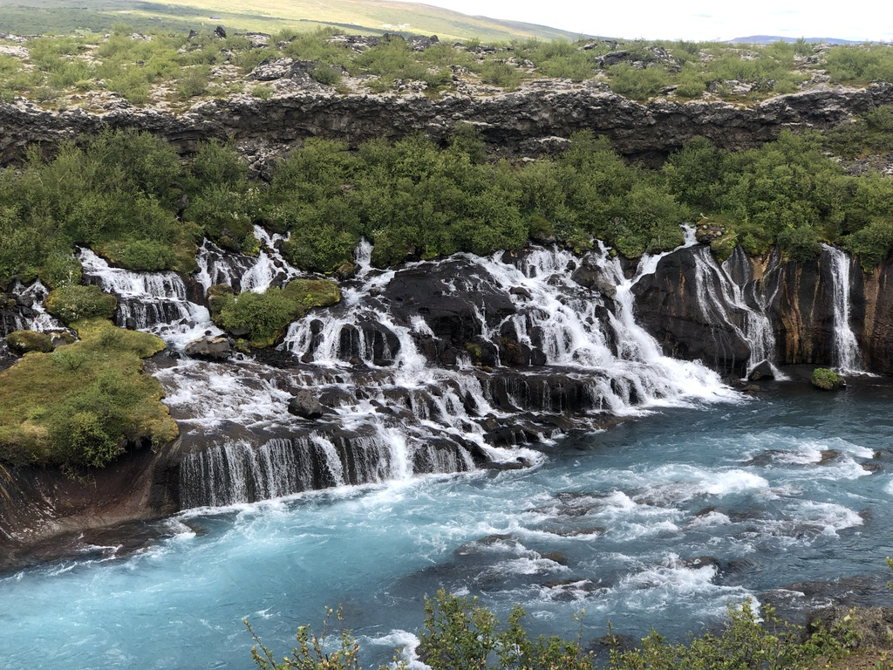
Power Automate (Flow)
List Triggers
JSON Flow

Slide 60
Go With The Flow

Slide 61
Go With The Flow
Flows run as the user that created them

Slide 62
Go With The Flow
Flows run as the user that created them
Create a service account

Slide 63
Go With The Flow
Flows run as the user that created them
Create a service account
Take an encapsulated approach to development

Slide 64
Go With The Flow
Flows run as the user that created them
Create a service account
Take an encapsulated approach to development
Name your flows well and consistently

Slide 65
Agenda
Current Options for Navigation
Anatomy of the Solution
Solution Architecture
Q&A

Slide 66
Power Automate Architecture
L1 On Delete
L1 On Create or Modify
L2 On Create or Modify
L2 On Delete
HTTP Trigger
List Triggers
Logic that reads list and generates the JSON

Slide 67
Power Automate Architecture
L1 On Delete
L1 On Create or Modify
L2 On Create or Modify
L2 On Delete
HTTP Trigger
List Triggers
Logic that reads list and generates the JSON

Slide 68
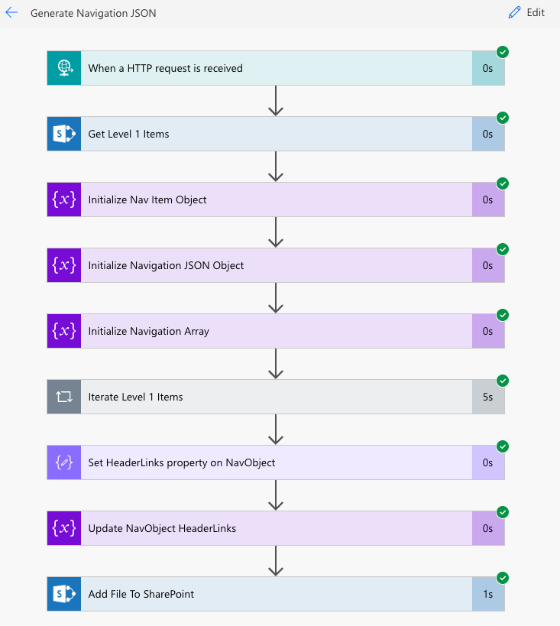
HTTP Trigger

Slide 69
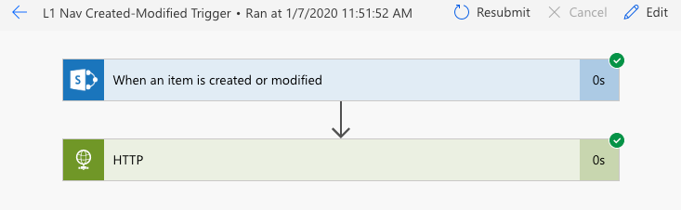
List Trigger

Slide 70
Demo

Slide 71
Standard Navigation Update Process
Need Change to Navigation
Call Developer or Open Support Ticket
Wait for developer to have time
Developer makes change
Review Change
Iterate on change
Approve Change
Wait for Change Window
Launch Change

Slide 72
New Navigation Update Process
Need Change to Navigation
Make Navigation Change
Wait for Flow to Run
Launch Change

Slide 73

Recap

Slide 74
Recap
Reviewed different out of the box navigation options

Slide 75
Recap
Reviewed different out of the box navigation options
Site/List set up

Slide 76
Recap
Reviewed different out of the box navigation options
Site/List set up
Power Automate set up

Slide 77
Resources
PnP Site
https://pnp.github.io/
SPFx Dev Extensions
https://github.com/SharePoint/sp-dev-fx-extensions/tree/master/samples/react-menu-footer-classic-modern
The Code
https://github.com/dcashpeterson/Public-Samples
Twitter
@spdcp

Slide 78


